Slide 1
Frame Relay

Slide 2
FRAME RELAY
Frame Relay is a virtual-circuit wide-area network that was designed in response to demands for a new type of WAN in the late 1980s and early 1990s.

Slide 3
X.25 has several drawbacks:
X.25 has a low 64-kbps data rate
X.25 has extensive flow and error control at both the data link layer and the network layer.
Originally X.25 was designed for private use, not for the Internet. X.25 has its own network layer

Slide 4
Frame Relay is a wide area network with the following features:
Frame Relay operates at a higher speed (1.544 Mbps and recently 44.376 Mbps).
Frame Relay operates in just the physical and data link layers.
Frame Relay allows bursty data.
Frame Relay allows a frame size of 9000 bytes, which can accommodate all local area network frame sizes.
Frame Relay is less expensive than other traditional WANs.
Frame Relay has error detection at the data link layer only.

Slide 5
Architecture:
Virtual Circuits
VCIs in Frame Relay are called DLCIs.
2. Permanent Versus Switched Virtual Circuits
3. Switches

Slide 6
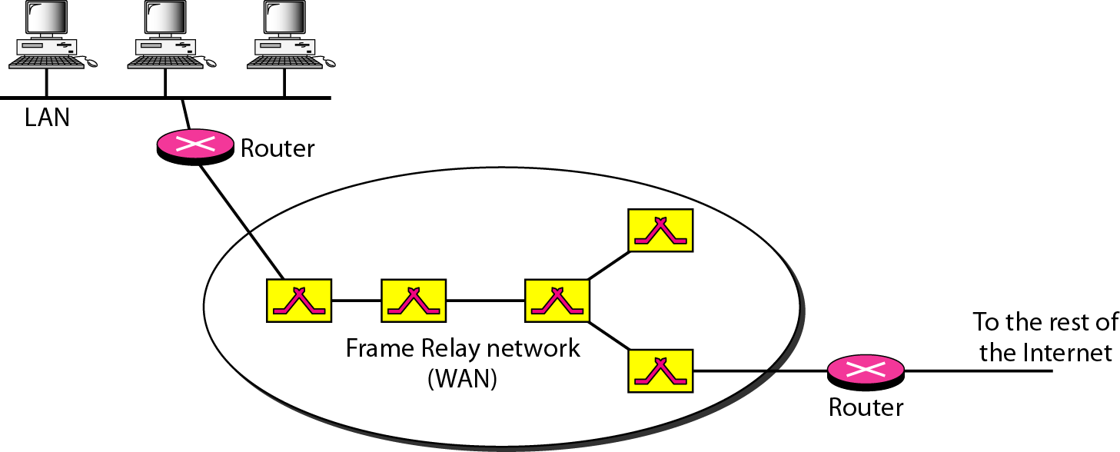
Frame Relay network

Slide 7
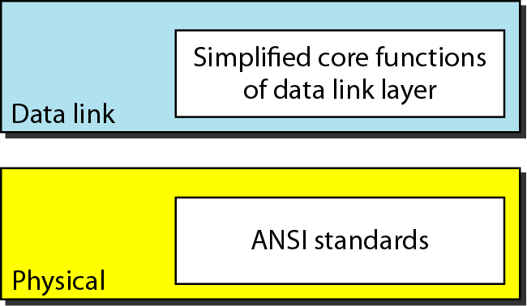
Frame Relay layers

Slide 8
Frame Relay Layers :
Frame Relay operates only at the physical and data link layers.
Physical Layer - No specific protocol is defined for the physical layer in Frame Relay. Instead, it is left to the implementer to use whatever is available. Frame Relay supports any of the protocols recognized by ANSI.
Data Link Layer - At the data link layer, Frame Relay uses a simple protocol that does not support flow or error control. It only has an error detection mechanism.

Slide 9
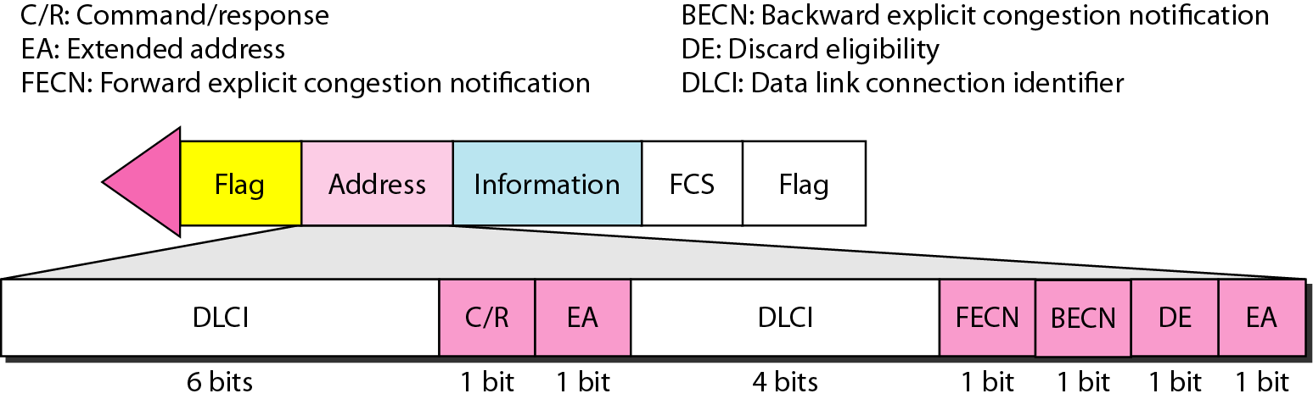
Frame Relay frame format

Slide 10
Frame Format (continued)
Flag: An eight-bit binary sequence (01111110) that indicates the start of the data frame
Address: Two to four bytes that contain several pieces of Frame Relay information
Ethertype: Identifies the type of higher-layer protocol being encapsulated (IP, IPX, or AppleTalk)
Data: A variable-length field that contains the information from the higher layers encapsulated in the Frame Relay frame
FCS: Frame check sequence (FCS) or cyclical redundancy check (CRC) used to ensure that the frame was not corrupted during transmission
Flag: An eight-bit binary sequence (01111110) that indicates the end of the data frame

Slide 11
Frame Format (continued)
Frame Relay Address Field descriptions:
  C/R: A command or response bit that is used for sending connection management and frame acknowledgment information between stations
  FECN: Setting used to alert receiving devices if the frame experiences congestion
  BECN: Setting used on frames traveling away from the congested area to warn source devices that congestion has occurred on that path
  DE: Discard eligible bit that is used to identify frames that are first to be dropped when the CIR is exceeded
  EA: Extension address bits that are used to extend the Address field from two bytes to either three or four bytes

Slide 12
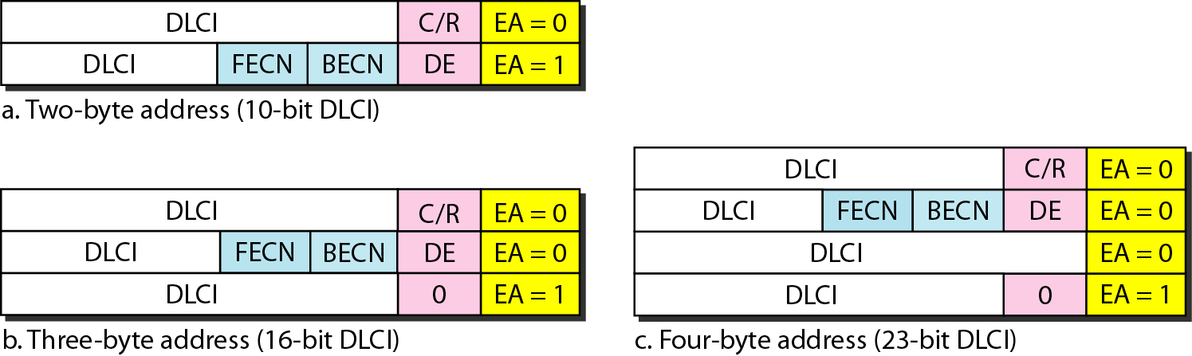
Three address formats

Slide 13
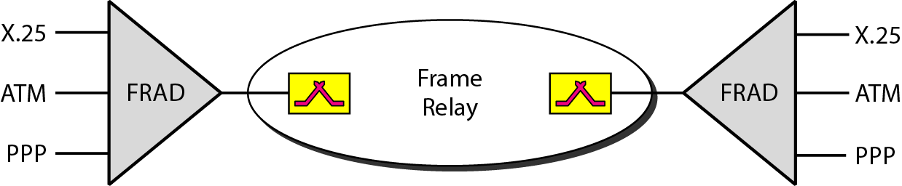
FRAD

Slide 14
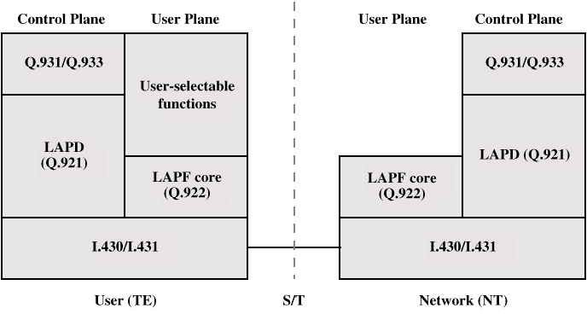
Protocol Architecture

Slide 15
Control Plane
Between subscriber and network
Separate logical channel used
  Similar to common channel signaling for circuit switching services
Data link layer
  LAPD (Q.921)
  Reliable data link control
  Error and flow control
  Between user (TE) and network (NT)

Slide 16
User Plane
End to end functionality
Transfer of info between ends
LAPF (Link Access Procedure for Frame Mode Bearer Services) Q.922
  Frame delimiting, alignment and transparency
  Frame mux and demux using addressing field
  Ensure frame is integral number of octets (zero bit insertion/extraction)
  Ensure frame is neither too long nor short
  Detection of transmission errors
  Congestion control functions

Slide 17
User Data Transfer
One frame type
  User data
  No control frame
No sequence numbers
  No flow nor error control

